Slide 1

Module 4: Assignment (Team Digital Presentation Group2)
ITC 6000
Database Management Systems

Slide 2
Agenda
Introduction
1
2
Database resources
3
Creating databases and tables
4
Trends and Patterns
5
Joining the Tables and relations
6
Key Takeaways

Slide 3

Introduction
HIV DATA FOR ASIAN COUNTRIES
Venkatesh Guri
Lystra
Tejaswini
Kalyan Kumar Bhogi
HIV data for Asian Countries from 2008 to 2017
Countries population, GDP per capita, and unemployment data from 2008 to 2017

Slide 4



Data resources & Tools
Databases:
UNICEF HIV
UN Data, and UNAIDS
World Bank Data
WHO-HIV
Technnical Tools :
MY SQL
EXCEL

Slide 5
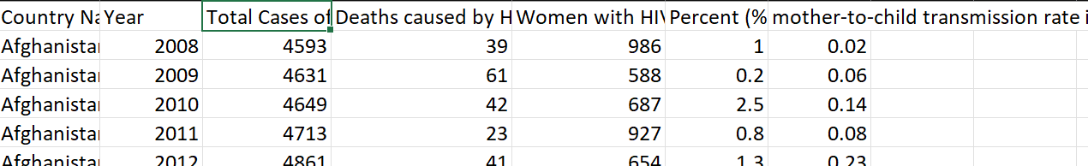
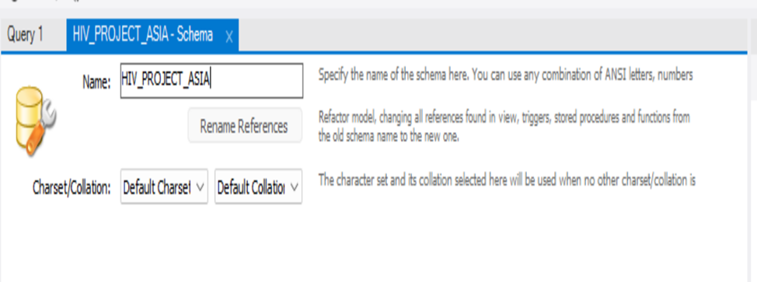
Creating Data Sets and Database

Slide 6

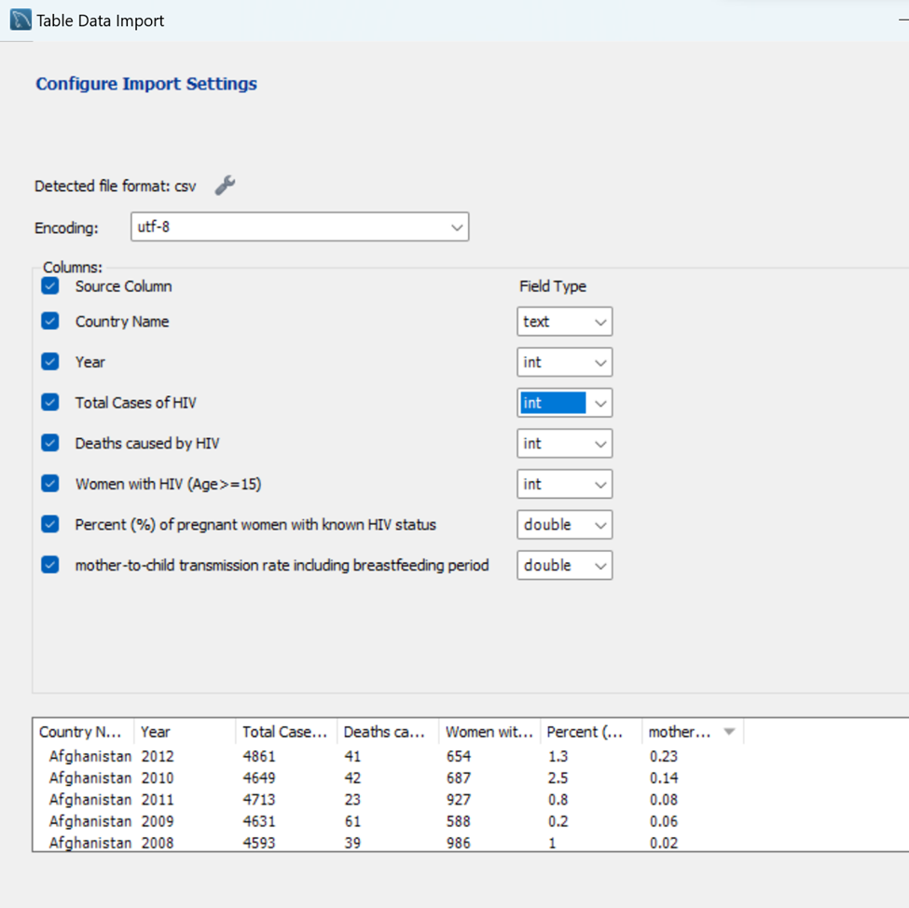
Creating tables

Slide 7
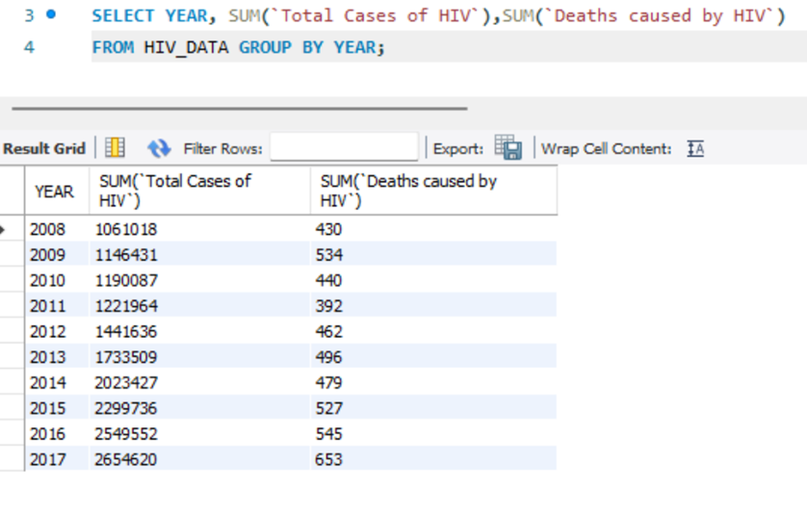
Creating trend graphs within Attributes

Slide 8
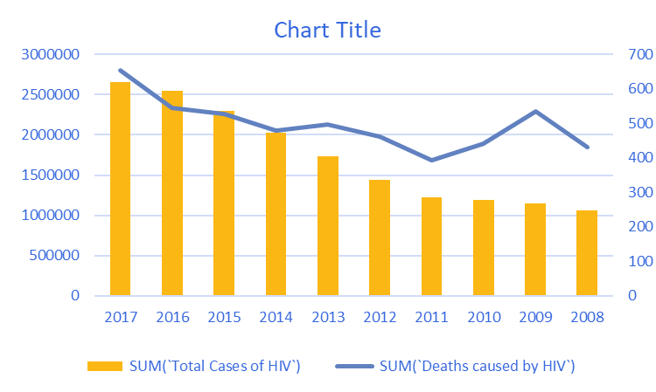
Number of people living with HIV
Total HIV cases in Asia has seen a steady rise to a count of 2600000 in 2017 from 1000000 in 2008

Slide 9
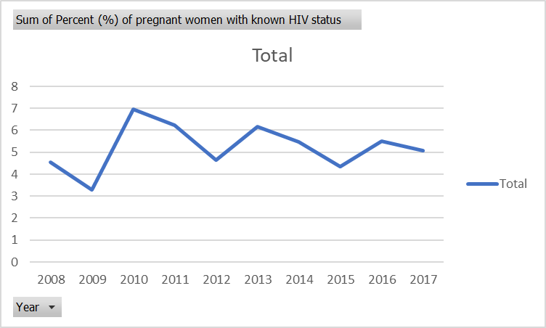
Trend Graphs: Percent (%) of pregnant women with known HIV status
Pregnant women count with HIV has increased enormously from 2009 to 2010 and reduced to a value of 4.7 in 2012. Overall from 2008 to 2017 there isn't considerable change.

Slide 10
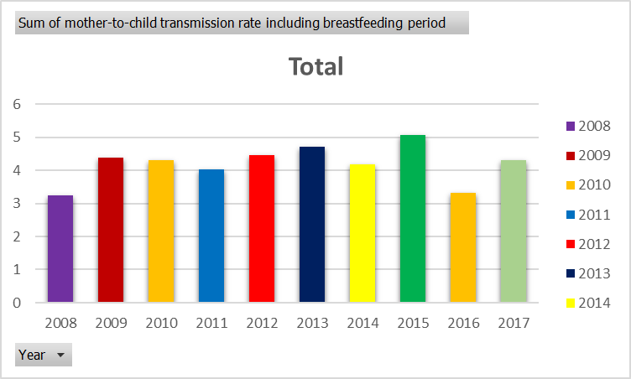
Final mother-to-child transmission rate
Mother to child transmission rate increased from 2008 (3.2%) to 2009(4.3%) and reached a peak of (5.11%)

Slide 11
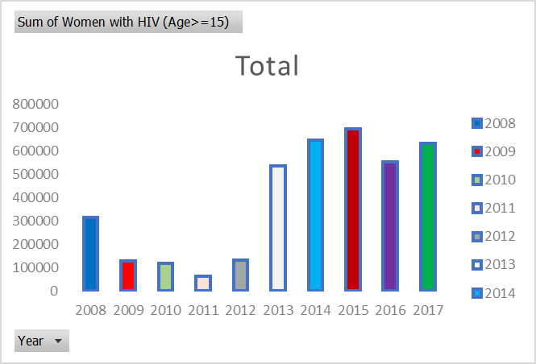
Number of women (15 and older) living with HIV

Slide 12
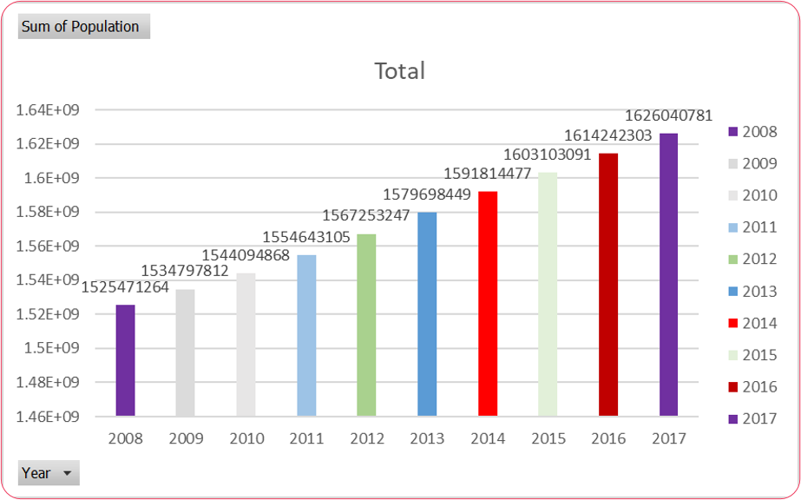
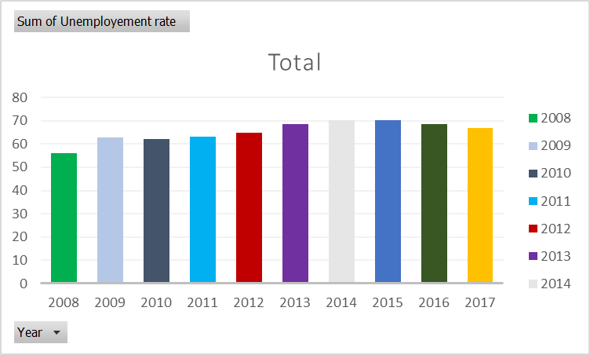
Total Unemployment rate and population

Slide 13
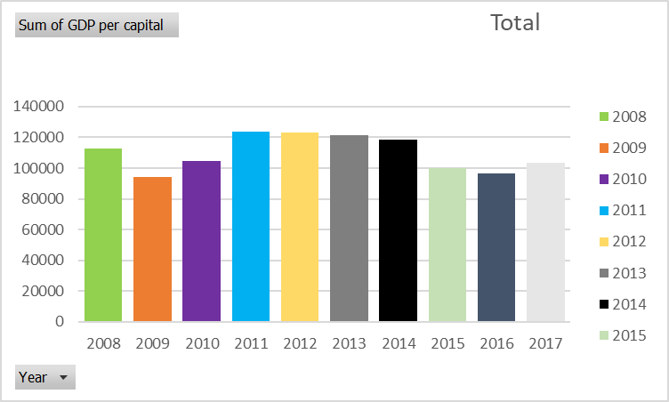
Table 2 Attributes Country’s GDP

Slide 14
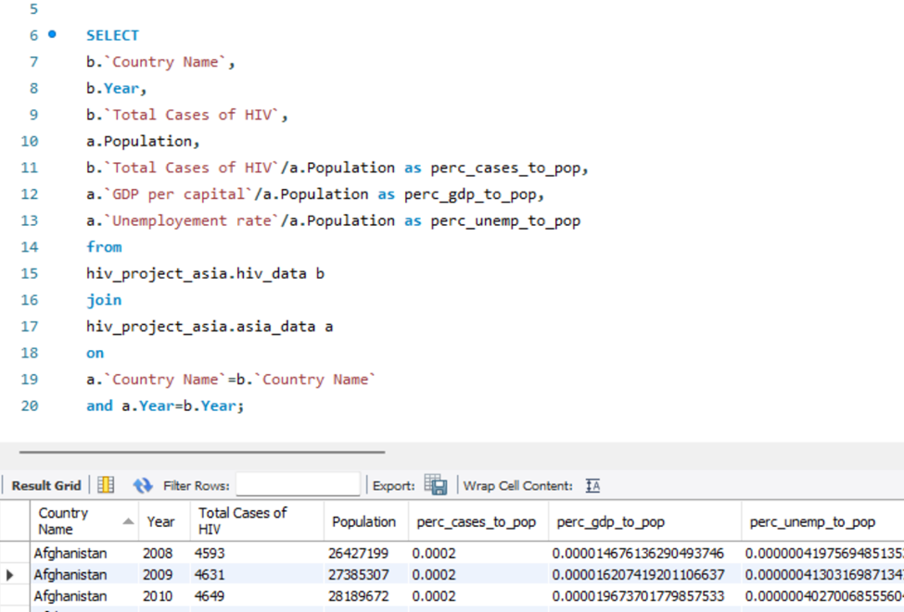
Joining the Table 1 and Table 2

Slide 15
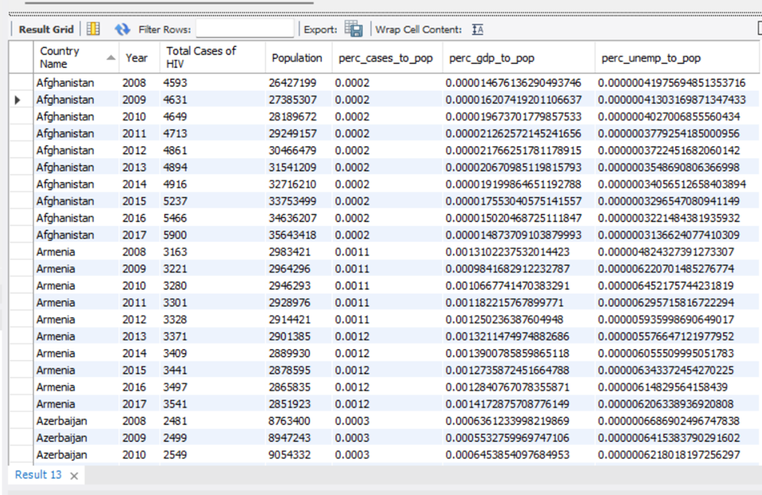
Number of people living with HIV” by country population

Slide 16
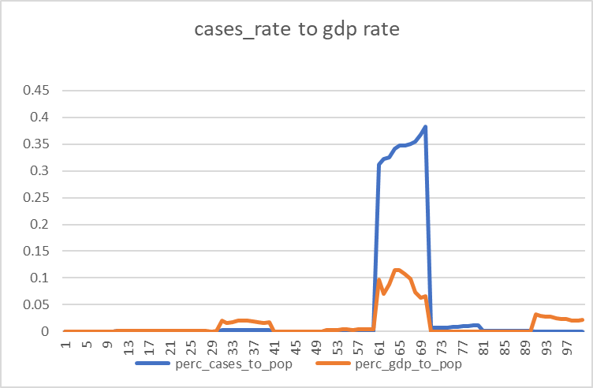
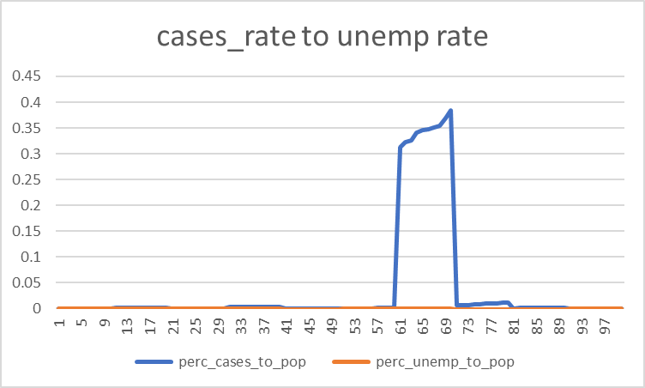
Relation of Cases rate to a country’s GDP and unemployment rate

Slide 17
Key findings
We came to the conclusion that there were fewer new HIV infections when the unemployment rate rose. HIV infection rates rose when the unemployment rate fell.
Also we concluded that unemployment rate is not affected by HIV positive rate
Creating schemas, importing tables and joining tables using SQL
Perform data visualization using SQL and MS EXCEL

Slide 18
References
UNAIDS. (2021). Global AIDS update 2021. Retrieved from https://www.unaids.org/sites/default/files/media_asset/2021_Global_AIDS_Update_en.pdf
World Bank. (2021). World development indicators 2021. Retrieved from https://datacatalog.worldbank.org/dataset/world-development-indicators
UNICEF. (2021). Children and AIDS: Seventh stocktaking report 2021. Retrieved from https://www.unicef.org/publications/index_96790.html
https://www.gileadhiv.com/landscape/state-of-epidemic/?gclid=CjwKCAiA85efBhBbEiwAD7oLQIcgQbI8lc3TNMnDYI0TRn9ueUuucw8xwy9QqG9QOgq8kQWoeOkaoRoCeUAQAvD_BwE&gclsrc=aw.ds

